Slide 1
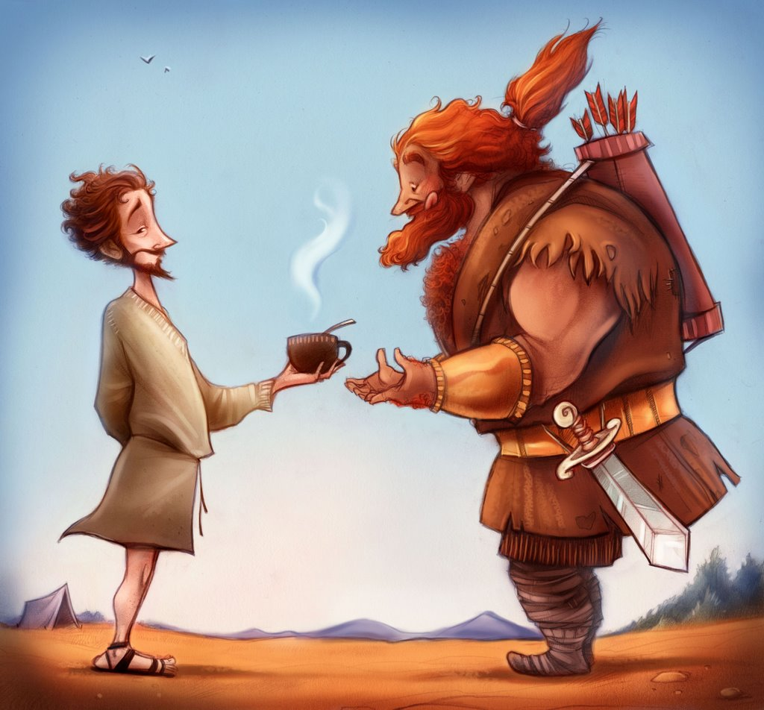
When
Esau
met
Jacob
Genesis 32
Designed and Preached by Student Paul Yeo Uploaded by Dr. Rick Griffith • Singapore Bible College All files in many languages for free download at BibleStudyDownloads.org

Slide 2
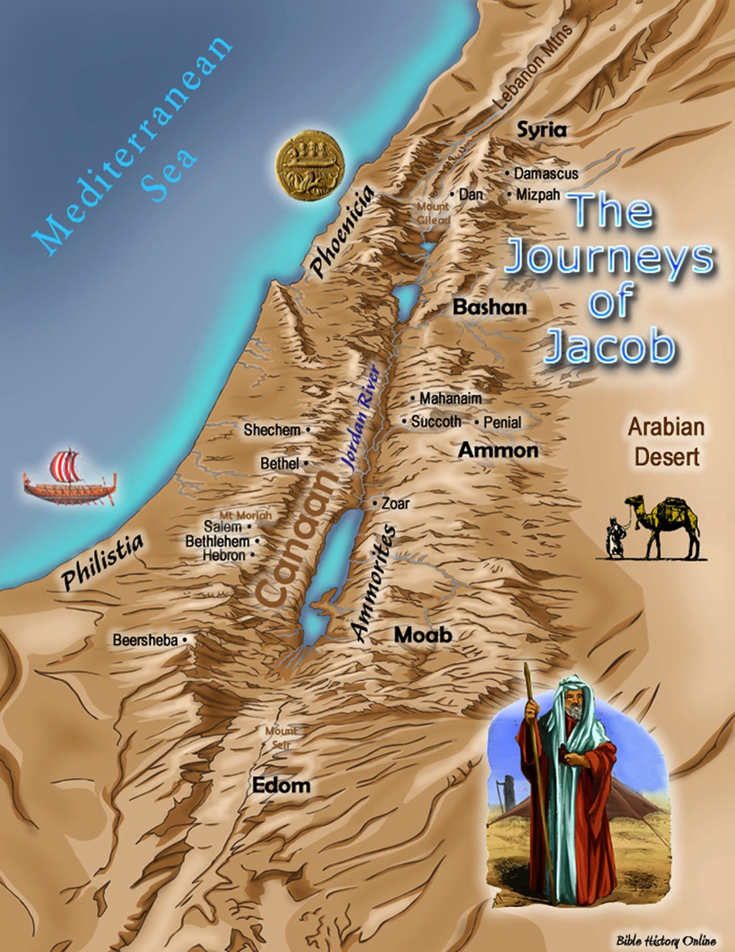
Genesis Chapter 32
Verses 1 -21
Beersheba: Esau deceived of both his birth right and blessing
Rebekah sent Esau to Laban
Jacob split with Laban at Mizpah

Slide 3
Genesis 32
1 - 21

Slide 4
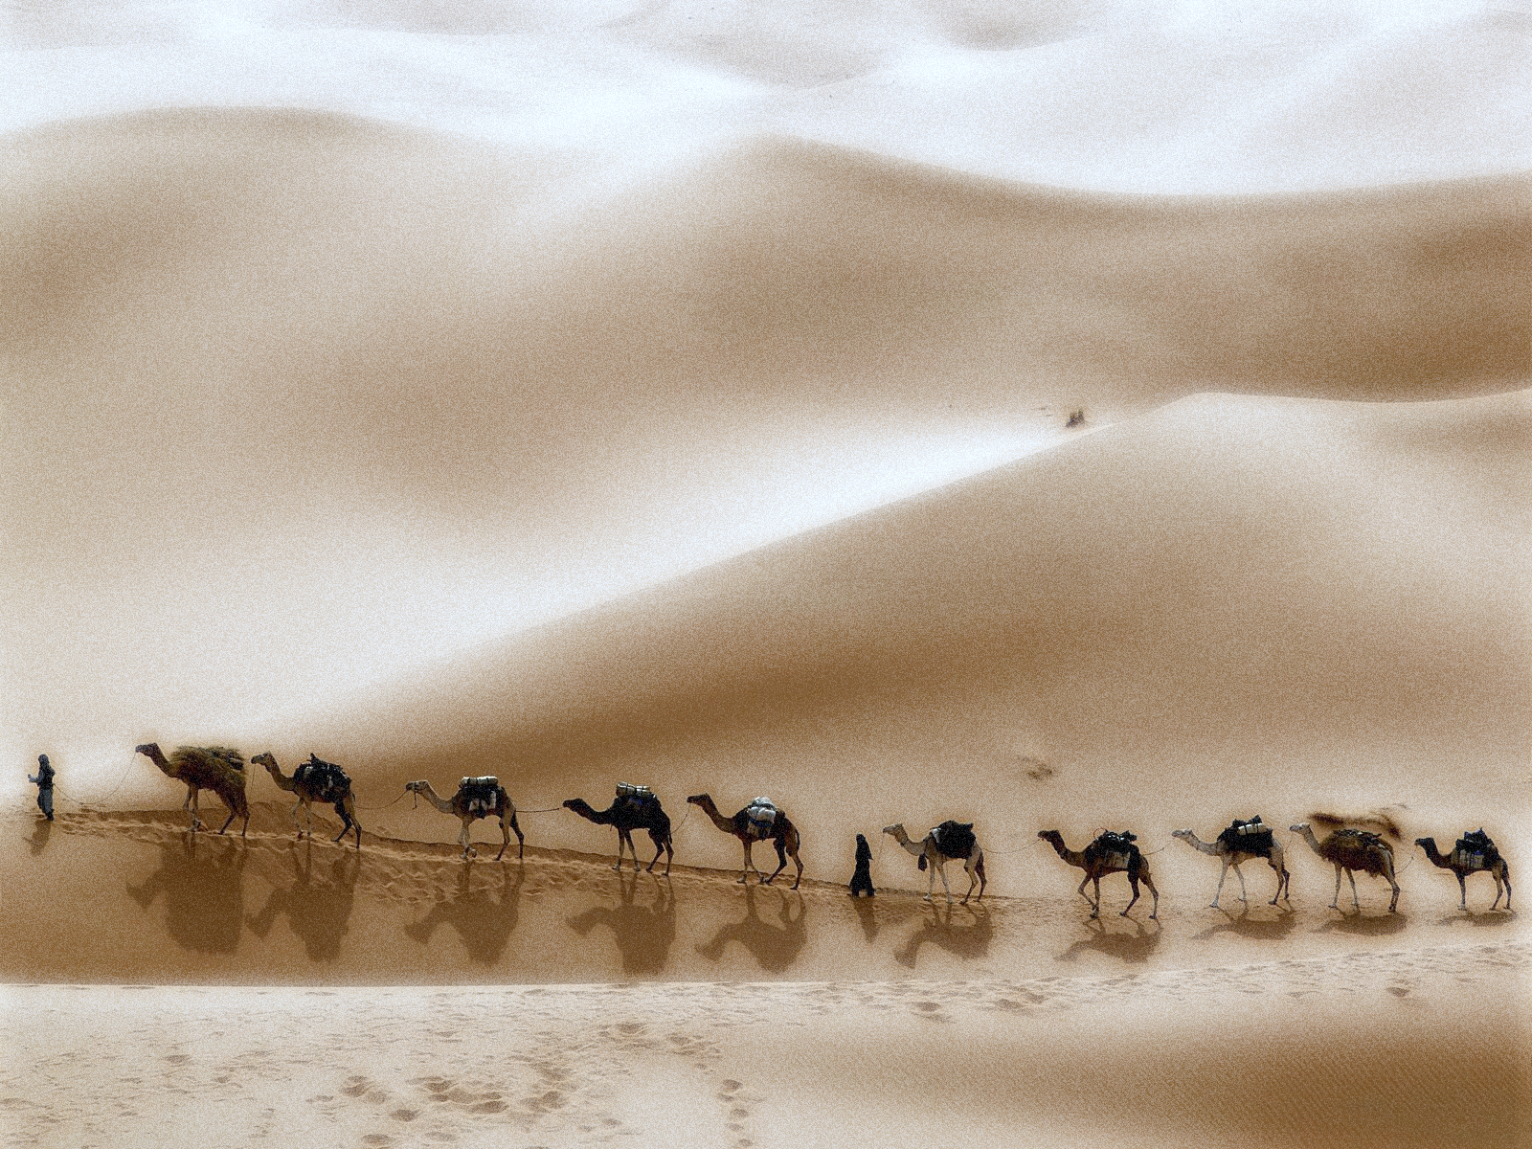
When
Esau
met
Jacob
1. Mahanaim, 2 camps - God’s camp is with Jacob’s camp
2. Gripped by fear Jacob divided his family into 2 camps
3. Jacob’s Prayer
4. Jacob sends Esau a peace offering

Slide 5
But how often we too, responded to challenges just like Jacob

Slide 6
Conclusion
When that day comes, are you able to say that you will not be like Jacob
You will not relinquish your calling just to escape the reality before you
However cruel it is

Slide 7
Black

Slide 8
OT Preaching link at BibleStudyDownloads.org
Get this presentation and script for free!
Notes:
OT Preaching (op)

